Slide 1
iSIGHT Partners
The Cyber Threat Intelligence Experts

Slide 2
iSIGHT Partners 200+ experts, 16 Countries, 24 Languages, 1 Mission
Mission
Global Reach
Be the world’s leading global cyber threat intelligence provider, connecting security technology and operations to the business.
Notes:
iSIGHT is the leading Cyber Threat Intelligence company in the world.
We have been in business for more than seven years and manage a worldwide operation with threat researchers situated around the globe to collect the latest threat information close to the source. Our researchers are native-language speakers that can decode and understand threat context first hand.
Our threat fusion center in Chantilly Virginia is where our expert team of cyber threat analysts produce and disseminate forward looking, adversary focused and actionable intelligence to our customers.

Slide 3
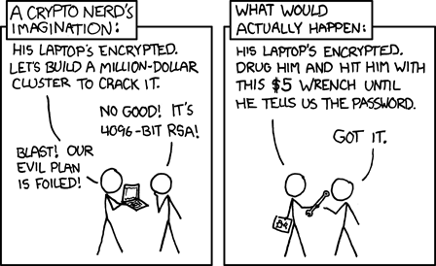
Understand Your Threat
3

Slide 4
Today’s Cyber Security Challenges
CISOs finding it difficult to define security ROI to executives Short shelf life for CISOs
Vastly expanding attack surface area Mobile, cloud, virtualization, global business operations
Large protection investments and no good prioritization filter Who, why, when, how
Operational chaos Too many alarms, not enough people, poor prioritization
“Brain dead” security tools that rely on past events/signatures Verses extremely agile adversaries
Severe breaches continue…
4
Notes:
There are a number of factors that are driving a sea change in how security is resourced and operated. Advanced organizations are well on their way through this transition… many others are following suit.

Slide 5
Global Cyber Threat Landscape
Active & Global
Transcends Geographies and Sectors
Multiple Motivations
Cyber Crime, Espionage, Hacktivism, Destruction, etc.
Low Entry Barriers
Actors use what works; not necessarily sophisticated methods
Open marketplace providing capabilities
Structured & Vibrant
Ecosystem providing better tools, infrastructure, sharing ideas and methods, pooling resources
Notes:
The Global Threat Landscape is vibrant and rapidly maturing.
The bad guys don’t pay attention to boarders.
These bad guys, or “Threat Actors” have multiple different reasons for attacking you ranging from cyber criminals interested in money to Espionage Actors that want your intellectual property or mission secrets
One of the major changes in the threat landscape is that it is very easy to get into the business. Many lower level bad guys often use unsophisticated methods because they still work. But there is also a very vibrant marketplace where bad guys can buy the latest tools, rent infrastructure and share ideas and best practices. In a nutshell this marketplace for capability is rapidly raising the sophistication of hackers globally.

Slide 6
Threat Intelligence VS Threat Data
ThreatScape® Cyber Threat Intelligence
WHO/WHAT? - Actors
- Groups
- Government Sponsors
“Actionable Intelligence”
Multi-faceted, forward looking, validated, highly contextual analysis
WHY/WHEN? - Motivation
- Intent
- Capabilities
HOW? - TTPs
- Methods
- Play Books
Based On
Multiple
Collection
Methods
Threat Data Feeds
One dimensional data
Narrow collection focus
No or limited validation and analysis
High noise-to-signal = many false positives
Increased alerts = wasted effort
Little/no prioritization context
Notes:
There is a very clear distinction between Threat Data and Threat Intelligence.
There are multiple vendors that provide threat “data feeds” with very limited context and often no actual analysis. These “feeds” can sometimes be helpful but they can also have multiple issues (name a few from the bullets on the slide)
Threat Intelligence by contrast is very rich information as represented by the multi-faceted balls. With the rich contextual information that we provide with ThreatScape subscriptions provides “ACTIONABLE INTELLIGENCE”
ThreatScape intelligence provides provides many data points including WHO the “Actors” (a.k.a bad guys) that are targeting you are, WHAT their motivation is, HOW they are or plan to come after you. This starts with data collected through multiples sources but ends with a comprehensive “high-fidelity” intelligence report.

Slide 7
How Can Cyber Threat Intelligence Help?
Be Proactive
Shrink the Problem
Improve Prioritization
Enhance Executive Communications
Connect Security With Business
CISO Recommendation:
“Use a commercial threat intelligence service to develop informed tactics for current threats, and plan for threats that may exist in the midterm future.”
Rob McMillan & Kelly Kavanagh
Technology Overview for Security Threat Intelligence Service Providers
Published: 16 October 2013
Notes:
So how can Cyber Threat Intelligence Help?
Let’s explore some of the key things cyber threat intelligence can help you do:
With cyber threat intelligence, you can ACTUALLY become proactive. For years “proactive” as used by the marketing teams from security vendors really meant “quickly reactive”. With cyber threat intelligence you can understand the adversaries you are facing, the methods and tactics they will likely use against you. With this knowledge you can proactively tune your defensive strategies.
Cyber threat intelligence you can This enables organizations to improve prioritization at the business, operational and tactical level.
Many of our customers get thousands or even tens of thousands of alarms each day. But they only have the capacity to investigate a small fraction of them. So which ones do you choose? Cyber threat intelligence can have a major impact on security operations by enabling organizations focus on the alerts and alarms that are most important based on the nature and severity of the threat.
Lastly, it is has been very difficult for many security teams to communicate with business leaders about the security program. With robust cyber threat intelligence you can say communicate, for example, that you blocked an attack by a major cyber espionage group that was targeting your intellectual property, or that you were able to thwart an attack by a hactivist group bent on damaging the corporate brand. This is a much different conversation than “we blocked 200 pieces of malware last week or responded to 1000 alarms.” Cyber threat intelligence provides the context that enables security professionals to connect with the business to better articulate return on investment from the security program or make a sound business case for additional funding.

Slide 8
All Cyber Threat Intelligence is Not Created Equal
“Many vendors can provide raw information, but there are only a comparative few that provide true intelligence capabilities.”
Rob McMillan & Kelly Kavanagh
Technology Overview for Security Threat Intelligence Service Providers
Published: 16 October 2013
Actionable Intelligence is:
Accurate
Aligned with your intelligence requirements
Integrated
Predictive
Relevant
Tailored
Timely
Rick Holland
Blog: Actionable Intelligence, Meet Terry Tate, Office Linebacker
Published: 11 February 2014
8

Slide 9
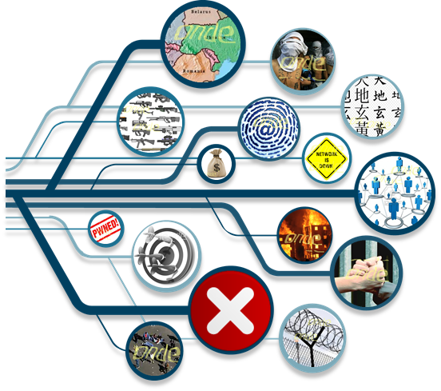
Shrink the problem
Attack Surface
INCIDENT INDICATORS
CORRELATED EVENTS
ATTACK ALERTS
Customer Side
People, process, and technology helps them determine possible risks.
Noise to Signal
Intelligence from iSIGHT
iSIGHT Intelligence helps them determine which events pose the greatest risk
to their unique organization.
VERIFIED THREAT INDICATORS
PRE-PROCESSED ANALYSIS
RAW OBSERVATIONS
Threat Sources
9

Slide 10
Changing the Cyber Security Discussion Putting “Threat” Back Into the Risk Equation
Geek Speak
Business Impact
Analyzed 1,452,134 logs
Detected 423,132 viruses
Blocked 2,028,438 connections
Closed 3,095 Incident Tickets
Patched 30,000 Systems
Prevented 2 Cyber-Crime Attacks
Linked to ABC Criminal Organization
Targeting POS Systems
Prevented theft of 10M Customer Credit Cards
Avoided $78M Loss:
Cleanup, Notification,
Brand Reputation & Revenue
Shareholder Lawsuit & Stock Drop
VS
10

Slide 11
How Is Intelligence Led Security Defined?
Intelligence-led security isn’t:
Just big-data technology integration
Just “dedicated” intelligence teams
Faster response times to security intelligence feeds
Our theory:
A paradigm shift from technology-based decisions to threat-based decisions
Adding context and prioritization to technical environments and observations
Workflow changes from reactive to proactive
Connecting to the business

Slide 12
How Is Intelligence Led Security Defined?
Intelligence-led security isn’t:
Just big-data technology integration
Just “dedicated” intelligence teams
Faster response times to security intelligence feeds
Our theory:
A paradigm shift from technology-based decisions to threat-based decisions
Adding context and prioritization to technical environments and observations
Workflow changes from reactive to proactive
Connecting to the business

Slide 13
Threat Examples
Confluence of Cyber Espionage and Cyber Crime TTPs
Overview of Point of Sale (PoS) Malware Development
Cyber Espionage: Use of Social Networking in Victimization
Analysts of the Ukrainian Conflict from a Hactivism Viewpoint
Critical Infrastructure Under Threat
Notes:
The Increasing Confluence of Cyber Crime and Cyber Espionage https://portal.isightpartners.com/tfc/portal/reports/viewerfull/trpt112022
Operational Net Assessment of Hacktivist Threats - January to March 2014 https://portal.isightpartners.com/tfc/portal/reports/viewer/trpt112643
Are Cyber Weapons a Good Military Option Against Critical Infrastructures? https://portal.isightpartners.com/tfc/portal/reports/viewer/trpt110315

Slide 14
Lessons Learned - Consortiums
Establish strong information sharing protocols
Drive Public/Private Partnership
Enable a culture of (Information) Security
Change the conversation to include business context
Employ basic information security hygiene
Continuously seek to understand the evolving threat
Recognize that you are not unique
Understand third party connections
Agree on standards and support them as a community
14
Notes:
Security as a business driver

